Slide 1
Monitoreo de modelos
Presentación con una selección de las slides de las dos primeras presentaciones de Chip Huyen que se pueden consultar en stanford-cs329s.github.io/syllabus.html
Julio Waissman | MCD/Unison | Aprendizaje Automático Aplicado

Slide 2
Natural labels
The model’s predictions can be automatically evaluated or partially evaluated by the system.
Examples:
ETA
Ride demand prediction
Stock price prediction
Ads CTR
Recommender system

Slide 3
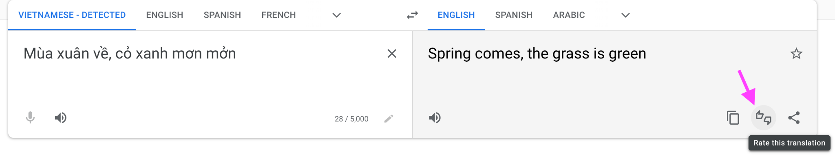
Natural labels
You can engineer a task to have natural labels

Slide 4
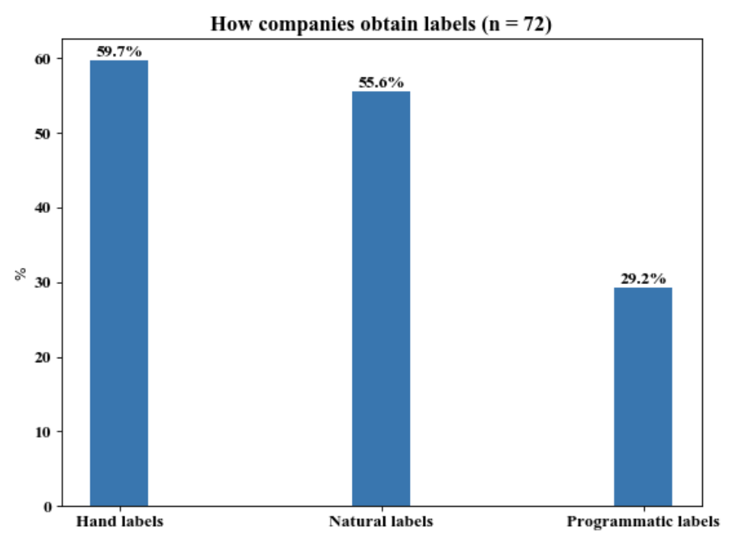
Natural labels: surprisingly common
⚠ Biases ⚠
Small sample size
Companies might only use ML for tasks with natural labels
Claypot AI’s real-time ML survey (2022)

Slide 5
Delayed labels
Prediction is served
Feedback is provided
Time
Feedback loop length
Short feedback loop: minutes -> hours
Reddit / Twitter / TikTok’s recommender systems
Long feedback loop: weeks -> months
Stitch Fix’s recommender systems
Fraud detection

Slide 6
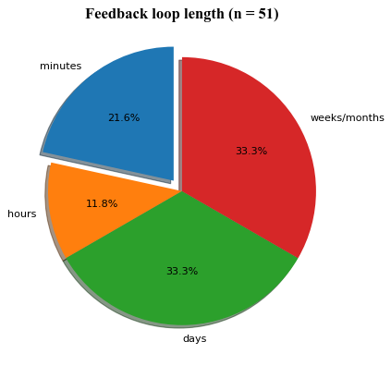

Claypot AI’s real-time ML survey (2022)

Slide 7
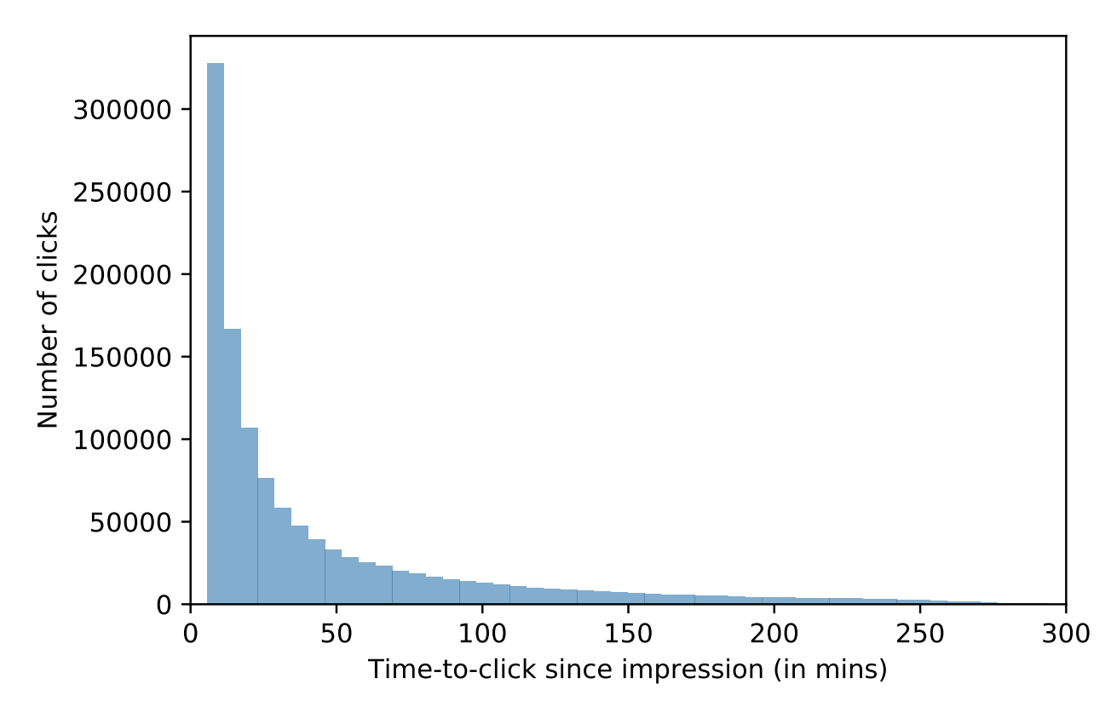
⚠ Labels are often assumed ⚠
Recommendation:
Click -> good rec
After X minutes, no click -> bad rec
Too short
Too long
False negatives
Slow feedback
Addressing Delayed Feedback for Continuous Training with Neural Networks in CTR prediction (Ktena et al., 2019)

Slide 8
Causes of ML failures

Slide 9
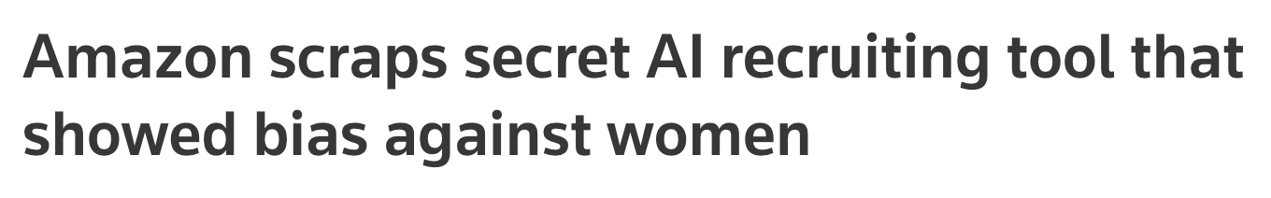
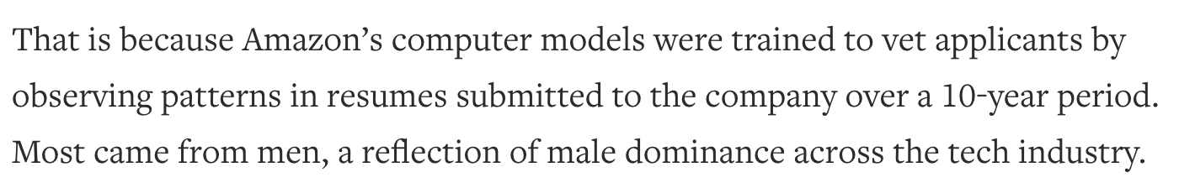
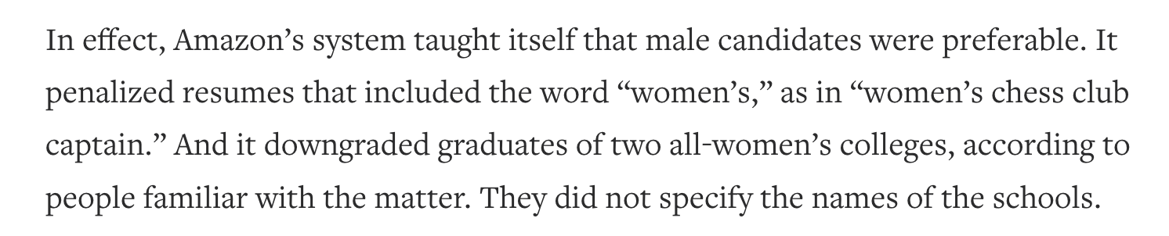
Amazon scraps secret AI recruiting tool that showed bias against women (Reuters, 2018)

Slide 10


“Guests complained their robot room assistants thought snoring sounds were commands and would wake them up repeatedly during the night.”
https://www.hotelmanagement.net/tech/japan-s-henn-na-hotel-fires-half-its-robot-workforce

Slide 11
What is an ML failure?
A failure happens when one or more expectations of the system is violated
Traditional software: mostly operational metrics
ML systems: operational + ML metrics
Ops: returns an English translation within 100ms latency on average
ML: BLEU score of 55 (out of 100)

Slide 12
ML system failures
If you enter a sentence and get no translation back -> ops failure
If one translation is incorrect -> ML failure?
Not necessarily: expected BLEU score < 100
ML failure if translations are consistently incorrect

Slide 13
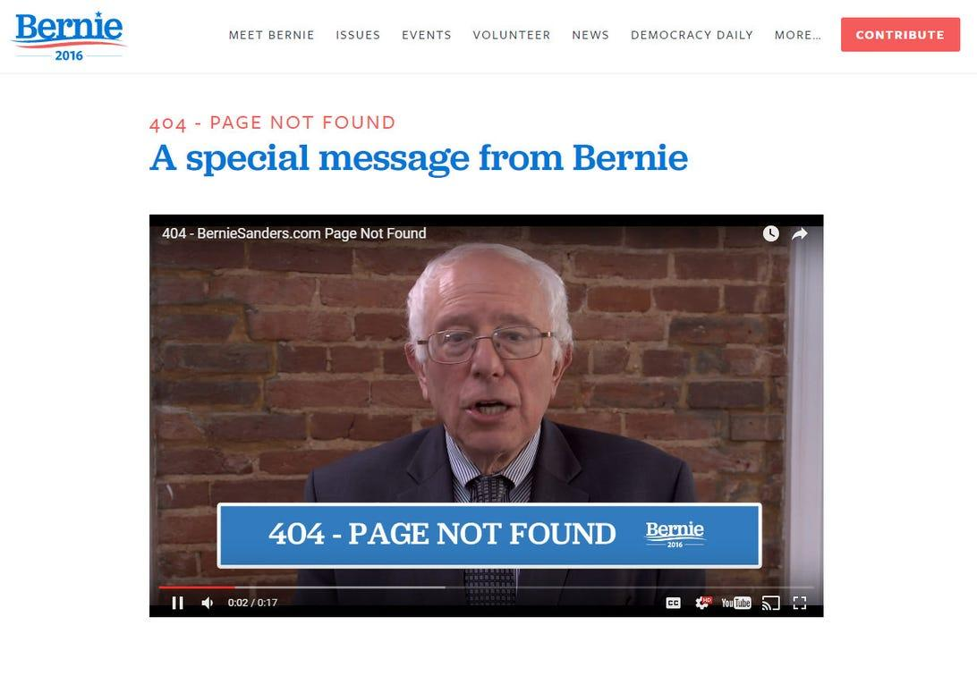
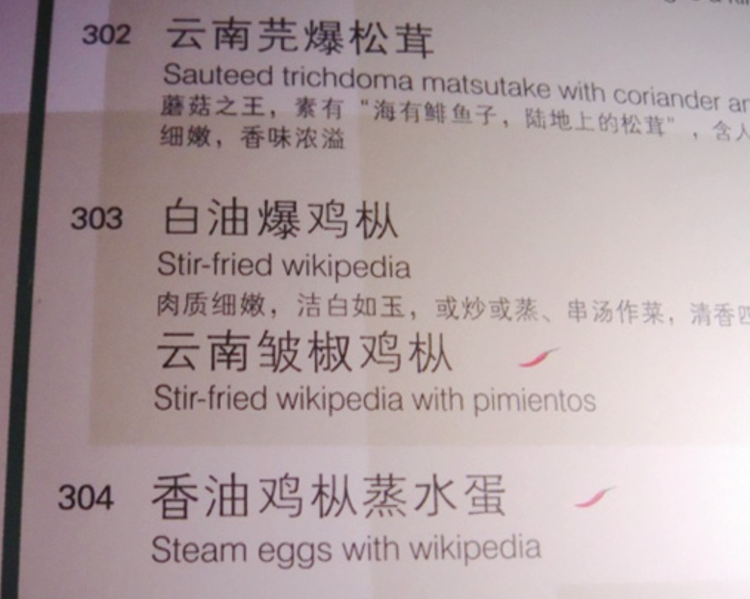
Ops failures | ML failures
Visible 404, timeout, segfault, OOM, etc. | Often invisible

Slide 14

Causes of ops failures (software system failures)
Dependency failures
Deployment failures
Hardware failures
Network failure: downtime / crash
60 / 96 ML systems failures are non-ML failures (Papasian & Underwood, 2020)
As tooling & best practices around ML production mature, there will be less surface for software failures

Slide 15
ML-specific failures (during/post deployment)
Production data differing from training data
Edge cases
Degenerate feedback loops
We’ve already covered problems pre-deployment in previous lectures!

Slide 16
Production data differing from training data
Train-serving skew:
Model performing well during development but poorly after production
Data distribution shifts
Model performing well when first deployed, but poorly over time
⚠ What looks like data shifts might be caused by human errors ⚠

Slide 17
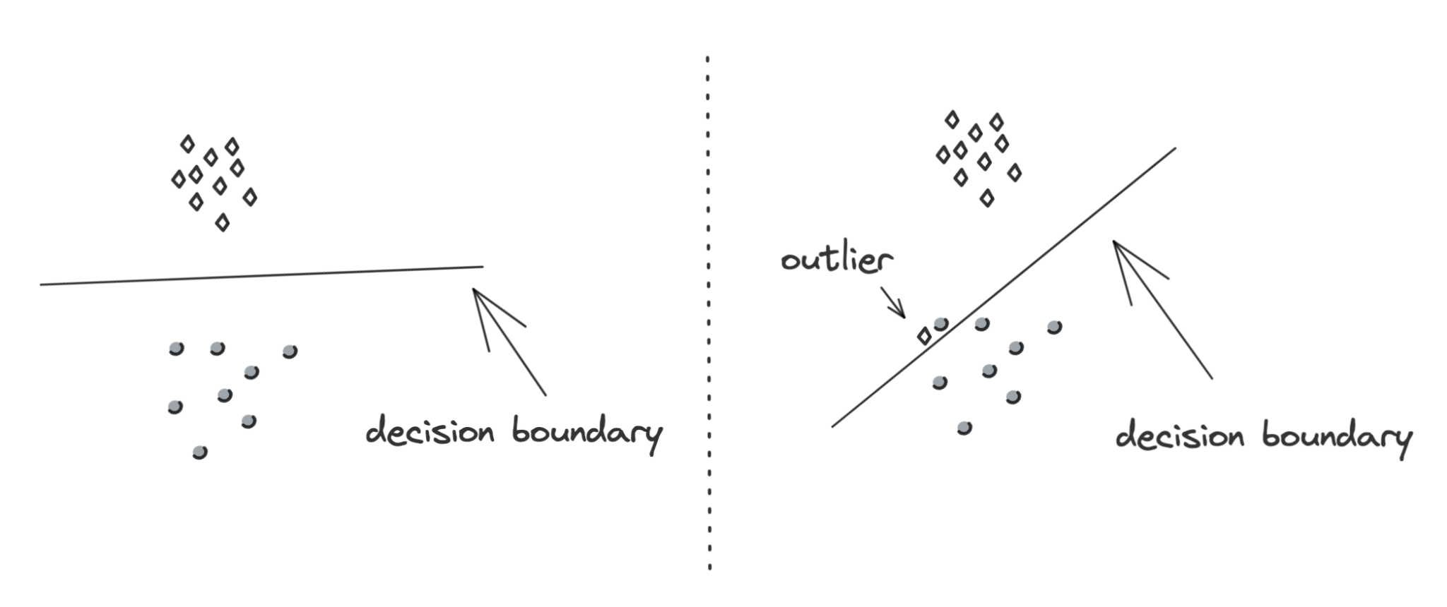
Edge case vs. outlier
Outliers
Refer to inputs
Options to ignore/remove
Edge cases
Refer to outputs
Can’t ignore/remove

Slide 18
Degenerate feedback loops
When predictions influence the feedback, which is then used to extract labels to train the next iteration of the model
Common in tasks with natural labels
Predictions
Users’ feedback
Training data

Slide 19
Degenerate feedback loops: recsys
Originally, A is ranked marginally higher than B -> model recommends A
After a while, A is ranked much higher than B
Model recommends item A
User clicks on A
Model confirms A is good

Slide 20
Degenerate feedback loops: resume screening
Originally, model thinks X is a good feature
Model only picks resumes with X
Hiring managers only see resumes with X, so only people with X are hired
Model confirms that X is good
Replace X with:
Has a name that is typically used for males
Went to Stanford
Worked at Google

Slide 21
Degenerate feedback loops: resume screening
Originally, model thinks X is a good feature
Model only picks resumes with X
Hiring managers only see resumes with X, so only people with X are hired
Model confirms that X is good
Tracking feature importance might help!

Slide 22
Detecting degenerate feedback loops
Only arise once models are in production -> hard to detect during training
Predictions
Users’ feedback
Training data

Slide 23
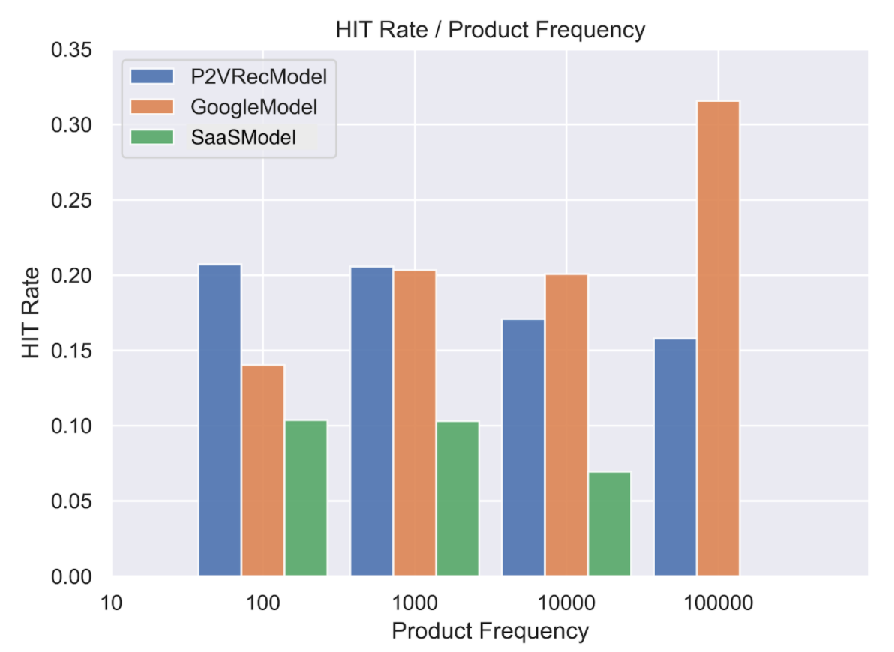
Degenerate feedback loops: detect
Average Rec Popularity (ARP)
Average popularity of the recommended items
Average Percentage of Long Tail Items (APLT)
average % of long tail items being recommended
Hit rate against popularity
Accuracy based on recommended items’ popularity buckets
Beyond NDCG: behavioral testing of recommender systems with RecList (Chia et al., 2021)

Slide 24
Degenerate feedback loops: mitigate
Randomization
Positional features

Slide 25
Randomization
Degenerate feedback loops increase output homogeneity
Combat homogeneity by introducing randomness in predictions

Slide 26
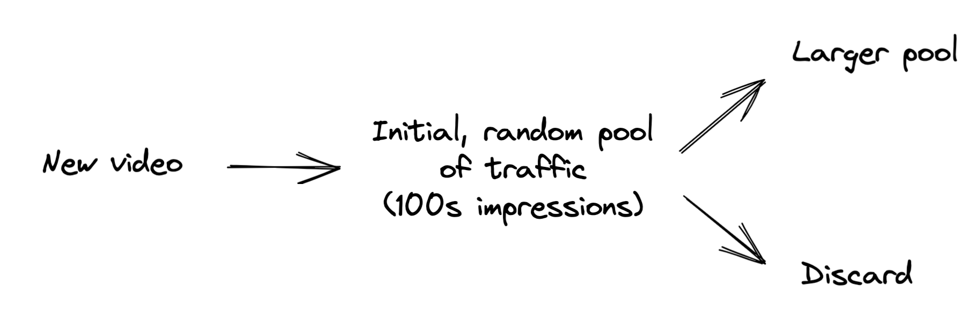

Randomization
Degenerate feedback loops increase output homogeneity
Combat homogeneity by introducing randomness in predictions
Recsys: show users random items & use feedback to determine items’ quality

Slide 27
Positional features
If a prediction’s position affects its feedback in any way, encode it.
Numerical: e.g. position 1, 2, 3, …
Boolean: e.g. shows first position or not

Slide 28
Positional features: naive
ID | Song | Genre | Year | Artist | User | 1st Position | Click
1 | Shallow | Pop | 2020 | Lady Gaga | listenr32 | False | No
2 | Good Vibe | Funk | 2019 | Funk Overlord | listenr32 | False | No
3 | Beat It | Rock | 1989 | Michael Jackson | fancypants | False | No
4 | In Bloom | Rock | 1991 | Nirvana | fancypants | True | Yes
5 | Shallow | Pop | 2020 | Lady Gaga | listenr32 | True | Yes
Set to False during inference

Slide 29
Positional features: 2 models
Predicts the probability that the user will see and consider a recommendation given its position.
Predicts the probability that the user will click on the item given that they saw and considered it.
Model 2 doesn’t use positional features

Slide 30
Data distribution shifts

Slide 31
Source distribution: data the model is trained on
Target distribution: data the model runs inference on

Slide 32
Types of data distribution shifts
Type | Meaning | Decomposition
Covariate shift | P(X) changes P(Y|X) remains the same | P(X, Y) = P(Y|X)P(X)
Label shift | P(Y) changes P(X|Y) remains the same | P(X, Y) = P(X|Y)P(Y)
Concept drift | P(X) remains the same P(Y|X) changes | P(X, Y) = P(Y|X)P(X)

Slide 33
Covariate shift
P(X) changes
P(Y|X) remains the same
Statistics: a covariate is an independent variable that can influence the outcome of a given statistical trial.
Supervised ML: input features are covariates

Slide 34
Covariate shift
P(X) changes
P(Y|X) remains the same
Statistics: a covariate is an independent variable that can influence the outcome of a given statistical trial.
Supervised ML: input features are covariates
Input distribution changes, but for a given input, output is the same

Slide 35
Covariate shift: example
P(X) changes
P(Y|X) remains the same
Predicts P(cancer | patient)
P(age > 40): training > production
P(cancer | age > 40): training = production

Slide 36
Covariate shift: causes (training)
P(X) changes
P(Y|X) remains the same
Predicts P(cancer | patient)
P(age > 40):
training > production
P(cancer | age > 40):
training = production
Data collection
E.g. women >40 are encouraged by doctors to get checkups
Closely related to sampling biases
Training techniques
E.g. oversampling of rare classes
Learning process
E.g. active learning

Slide 37
Covariate shift: causes (prod)
P(X) changes
P(Y|X) remains the same
Changes in environments
Ex 1: P(convert to paid user | free user)
New marketing campaign attracting users from with higher income
P(high income) increases
P(convert to paid user | high level) remains the same

Slide 38
Covariate shift: causes (prod)
P(X) changes
P(Y|X) remains the same
Changes in environments
Ex 2: P(Covid | coughing sound)
Training data from clinics, production data from phone recordings
P(coughing sound) changes
P(Covid | coughing sound) remains the same

Slide 39
Covariate shift
Research: if knowing in advance how the production data will differ from training data, use importance weighting
Production: unlikely to know how a distribution will change in advance

Slide 40
Label shift
P(Y) changes
P(X|Y) remains the same
Output distribution changes but for a given output, input distribution stays the same.

Slide 41
Label shift & covariate shift
Predicts P(cancer | patient)
P(age > 40): training > production
P(cancer | age > 40): training = production
P(cancer): training > production
P(age > 40 | cancer): training = prediction
P(X) changes
P(Y|X) remains the same
P(Y) changes
P(X|Y) remains the same
P(X) change often leads to P(Y) change, so covariate shift often means label shift

Slide 42
Label shift & covariate shift
Predicts P(cancer | patient)
New preventive drug: reducing P(cancer | patient) for all patients
P(age > 40): training > production
P(cancer | age > 40): training > production
P(cancer): training > production
P(age > 40 | cancer): training = prediction
P(X) changes
P(Y|X) remains the same
P(Y) changes
P(X|Y) remains the same
Not all label shifts are covariate shifts!

Slide 43
Concept Drift
P(X) remains the same
P(Y|X) changes
Same input, expecting different output
P(houses in SF) remains the same
Covid causes people to leave SF, housing prices drop
P($5M | houses in SF)
Pre-covid: high
During-covid: low

Slide 44
Concept Drift
P(X) remains the same
P(Y|X) changes
Concept drifts can be cyclic & seasonal
Ride sharing demands high during rush hours, low otherwise
Flight ticket prices high during holidays, low otherwise

Slide 45
General data changes
Feature change
A feature is added/removed/updated

Slide 46
General data changes
Feature change
A feature is added/removed/updated
Label schema change
Original: {“POSITIVE”: 0, “NEGATIVE”: 1}
New: {“POSITIVE”: 0, “NEGATIVE”: 1, “NEUTRAL”: 2}

Slide 47
Detecting data distribution shifts
How to determine that two distributions are different?

Slide 48
Detecting data distribution shifts
How to determine that two distributions are different?
Compare statistics: mean, median, variance, quantiles, skewness, kurtosis, …
Compute these stats during training and compare these stats in production

Slide 49
Detecting data distribution shifts
How to determine that two distributions are different?
Compare statistics: mean, median, variance, quantiles, skewness, kurtosis, …
Not universal: only useful for distributions where these statistics are meaningful

Slide 50
Detecting data distribution shifts
How to determine that two distributions are different?
Compare statistics: mean, median, variance, quantiles, skewness, kurtosis, …
Not universal: only useful for distributions where these statistics are meaningful
Inconclusive: if statistics differ, distributions differ. If statistics are the same, distributions can still differ.

Slide 51
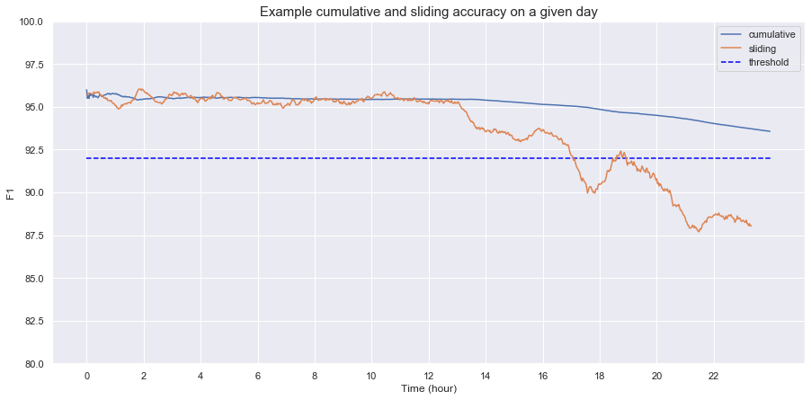
Cumulative vs. sliding metrics
Sliding: reset at each new time window
This image is based on an example from MadeWithML (Goku Mohandas).

Slide 52
Detecting data distribution shifts
How to determine that two distributions are different?
Compare statistics: mean, median, variance, quantiles, skewness, kurtosis, …
Two-sample hypothesis test
Determine whether the difference between two populations is statistically significant
If yes, likely from two distinct distributions
E.g.
Data from yesterday
Data from today
Notes:
The probability that the difference is a random fluctuation due to sampling variability is very low, and therefore, the difference is caused by the fact that these two populations come from two distinct distributions.

Slide 53
Two-sample test: KS test (Kolmogorov–Smirnov)
Pros
Doesn’t require any parameters of the underlying distribution
Doesn’t make assumptions about distribution
Cons
Only works with one-dimensional data
Useful for prediction & label distributions
Not so useful for features

Slide 54
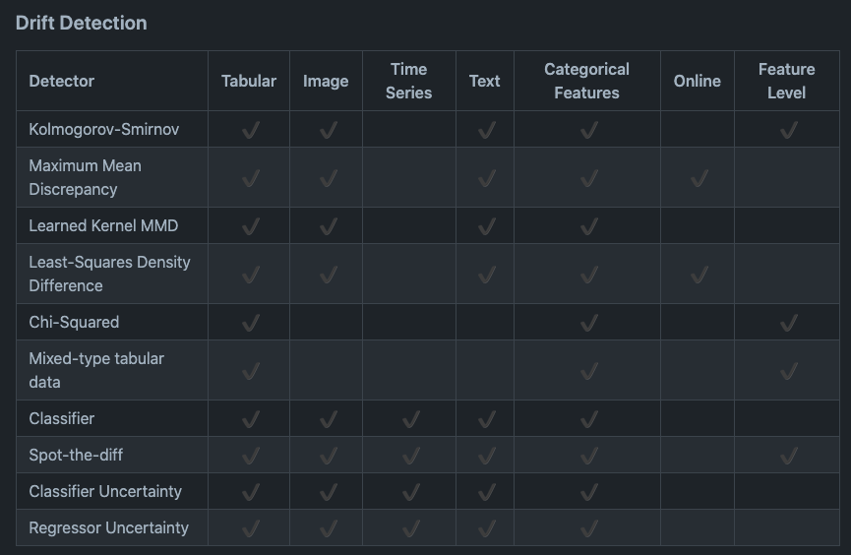
Two-sample test
alibi-detect (OS)
Most tests work better on low-dim data, so dim reduction is recommended beforehand!

Slide 55

Not all shifts are equal
Sudden shifts vs. gradual shifts
Sudden shifts are easier to detect than gradual shifts

Slide 56
Not all shifts are equal
Sudden shifts vs. gradual shifts
Spatial shifts vs. temporal shifts
New device (e.g. mobile vs. desktop)
New users (e.g. new country)
E.g. same users, same device, but behaviors change over time

Slide 57
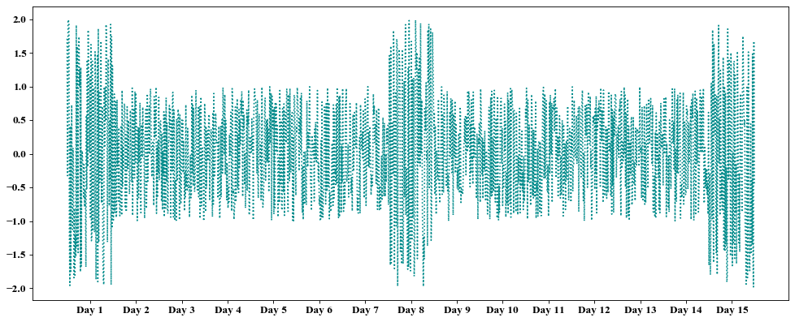
Temporal shifts: time window scale matters
Source distribution: unlikely a shift
Source distribution: likely a shift
Target distribution

Slide 58
Temporal shifts: time window scale matters
Difficulty is compounded by seasonal variation

Slide 59
Temporal shifts: time window scale matters
Too short window: false alarms of shifts
Too long window: takes long to detect shifts
Granularity level: hourly, daily

Slide 60
Temporal shifts: time window scale matters
Too short window: false alarms of shifts
Too long window: takes long to detect shifts
Granularity level: hourly, daily
Merge shorter time scale windows -> larger time scale window
RCA: automatically analyze various window sizes

Slide 61
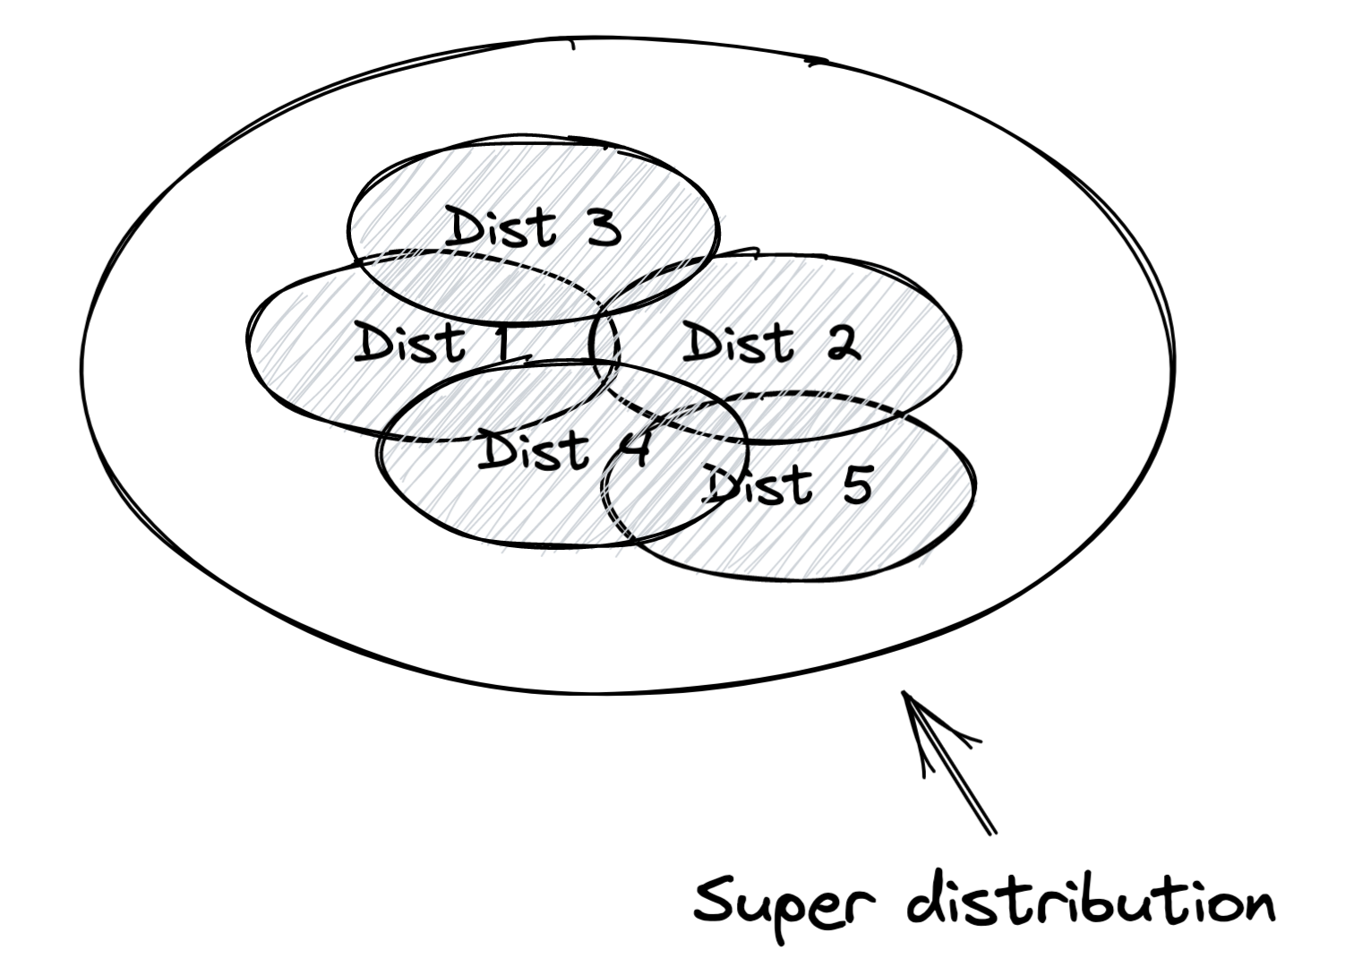
Addressing data distribution shifts
Train model using a massive dataset

Slide 62
Addressing data distribution shifts
Train model using a massive dataset
Retrain model with new data from new distribution
Mode
Train from scratch
Fine-tune

Slide 63
Addressing data distribution shifts
Train model using a massive dataset
Retrain model with new data from new distribution
Mode
Data
Use data from when data started to shift
Use data from the last X days/weeks/months
Use data form the last fine-tuning point
Need to figure out not just when to retrain models, but also how and what data

Slide 64
Monitoring & Observability

Slide 65
Monitoring vs. observability
Monitoring: tracking, measuring, and logging different metrics that can help us determine when something goes wrong
Observability: setting up our system in a way that gives us visibility into our system to investigate what went wrong

Slide 66
Monitoring vs. observability
Monitoring: tracking, measuring, and logging different metrics that can help us determine when something goes wrong
Observability: setting up our system in a way that gives us visibility into our system to investigate what went wrong
Instrumentation
adding timers to your functions
counting NaNs in your features
logging unusual events e.g. very long inputs
…

Slide 67
Monitoring vs. observability
Monitoring: tracking, measuring, and logging different metrics that can help us determine when something goes wrong
Observability: setting up our system in a way that gives us visibility into our system to investigate what went wrong
Observability is part of monitoring

Slide 68
Monitoring is all about metrics
Operational metrics
ML-specific metrics

Slide 69
Operational metrics
Latency
Throughput
Requests / minute/hour/day
% requests that return with a 2XX code
CPU/GPU utilization
Memory utilization
Availability
etc.

Slide 70
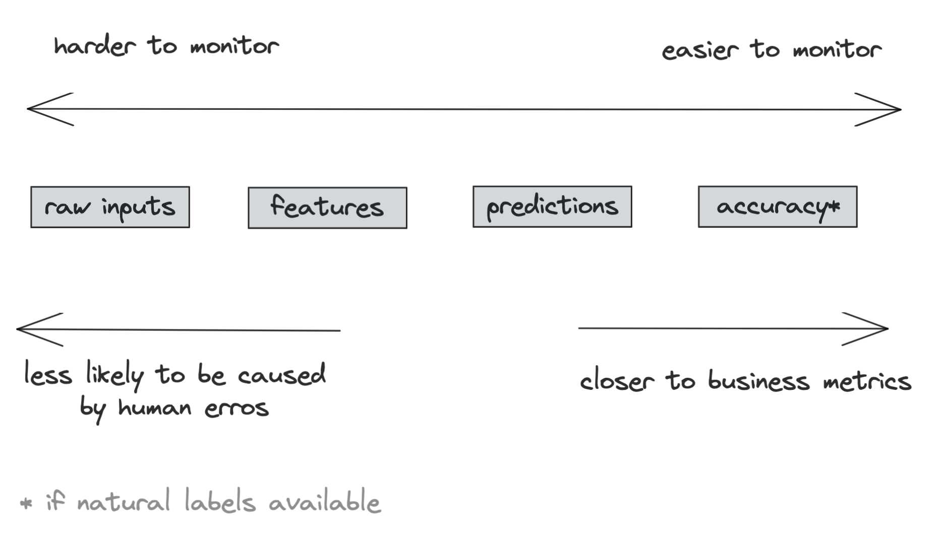
ML metrics: what to monitor

Slide 71
Monitoring #1: accuracy-related metrics
Most direct way to monitor a model’s performance
Can only do as fast as when feedback is available

Slide 72
Monitoring #1: accuracy-related metrics
Most direct way to monitor a model’s performance
Collect as much feedback as possible
Example: YouTube video recommendations
Click through rate
Duration watched
Completion rate
Take rate

Slide 73
Monitoring #2: predictions
Predictions are low-dim: easy to visualize, compute stats, and do two-sample tests
Changes in prediction dist. generally mean changes in input dist.

Slide 74
Monitoring #2: predictions
Predictions are low-dim: easy to visualize, compute stats, and do two-sample tests
Changes in prediction dist. generally mean changes in input dist.
Monitor odd things in predictions
E.g. if predictions are all False in the last 10 mins

Slide 75
Monitoring #3: features
Most monitoring tools focus on monitoring features
Feature schema expectations
Generated from the source distribution
If violated in production, possibly something is wrong
Example expectations
Common sense: e.g. “the” is most common word in English
min, max, or median values of a feature are in [a, b]
All values of a feature satisfy a regex
Categorical data belongs to a predefined set
FEATURE_1 > FEATURE_B

Slide 76
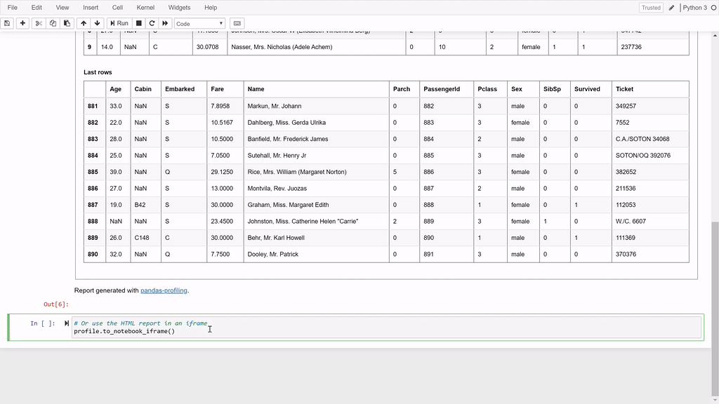
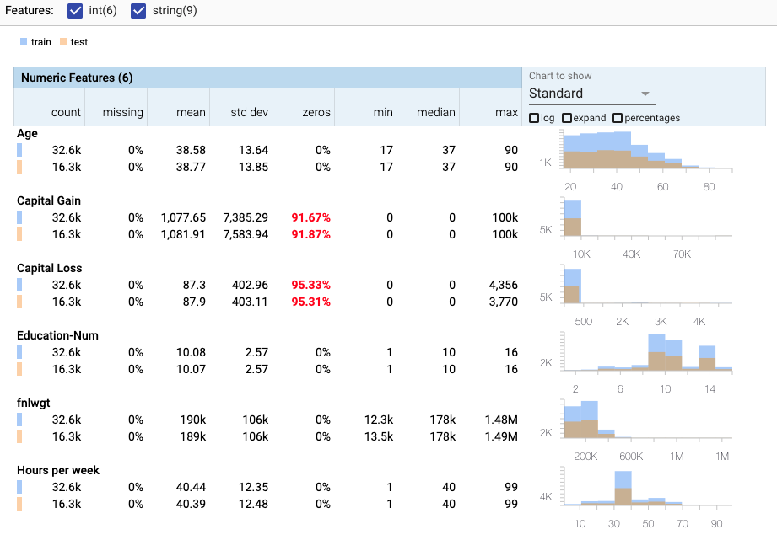
Generate expectations with profiling & visualization
Examining data & collecting:
statistics
informative summaries
pandas-profiling
facets

Slide 77
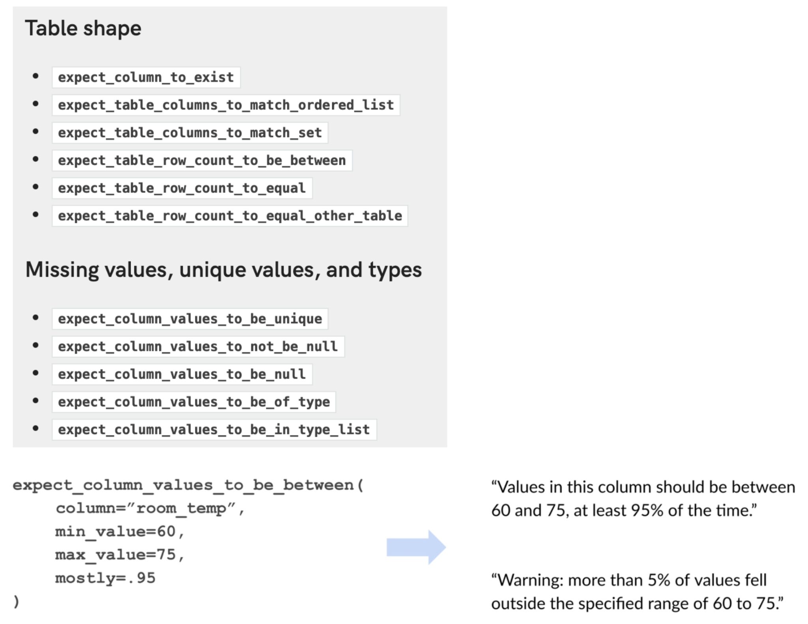
Monitoring #3: features
Feature schema expectations
GitHub - great-expectations/great_expectations

Slide 78
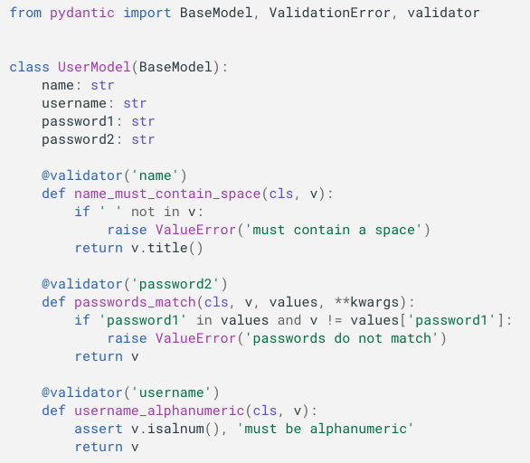
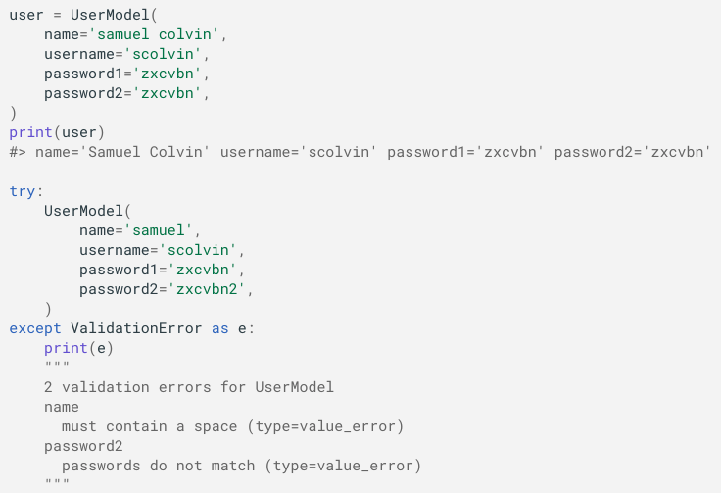
Monitoring #3: features schema with pydantic
https://pydantic-docs.helpmanual.io/usage/validators/

Slide 79

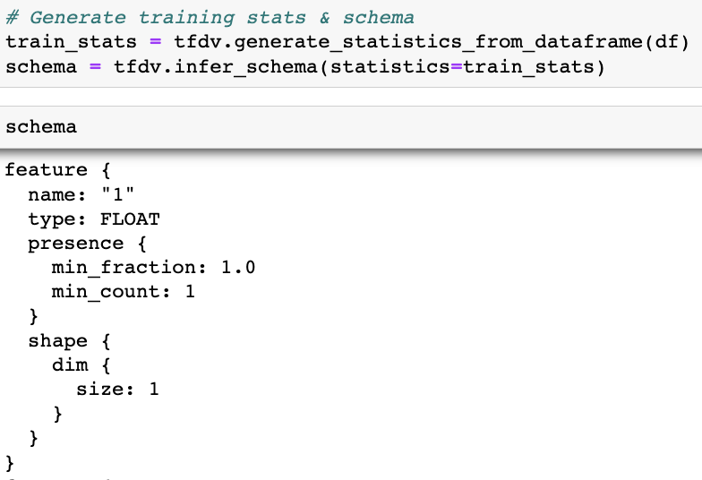

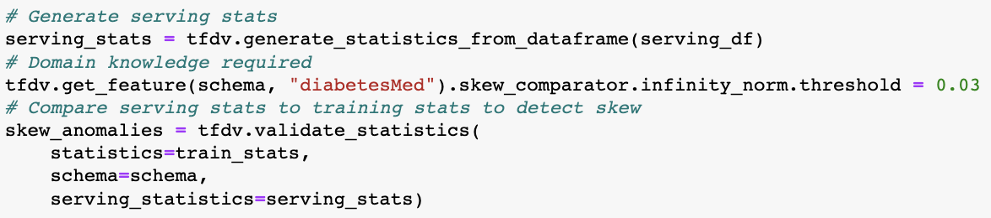

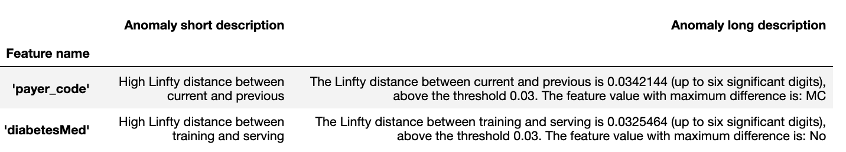
Monitoring #3: features schema with TFX
How To Evaluate MLOps Tools (Hamel Husain, CS 329S Lecture 9, 2022)

Slide 80
Feature monitoring problems
Compute & memory cost
100s models, each with 100s features
Computing stats for 10000s of features is costly

Slide 81
Feature monitoring problems
Compute & memory cost
Alert fatigue
Most expectation violations are benign

Slide 82
Feature monitoring problems
Compute & memory cost
Alert fatigue
Schema management
Feature schema changes over time
Need to find a way to map feature to schema version

Slide 83
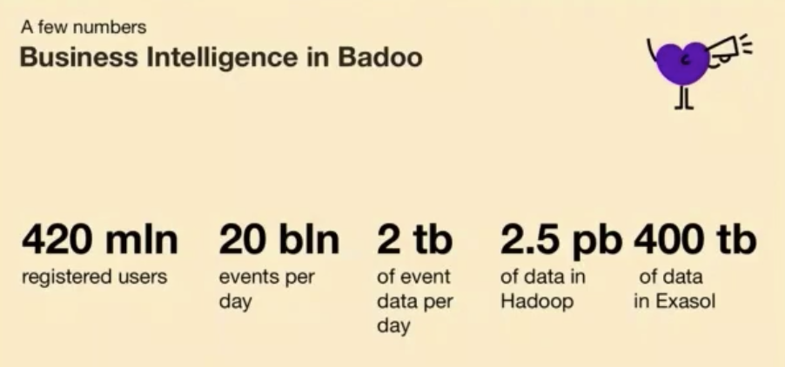
Monitoring toolbox: logs
Log everything
A stream processing problem
Vladimir Kazanov (Badoo 2019)
“If it moves, we track it. Sometimes we’ll draw a graph of something that isn’t moving yet, just in case it decides to make a run for it.”
Ian Malpass (Etsy 2011)

Slide 84
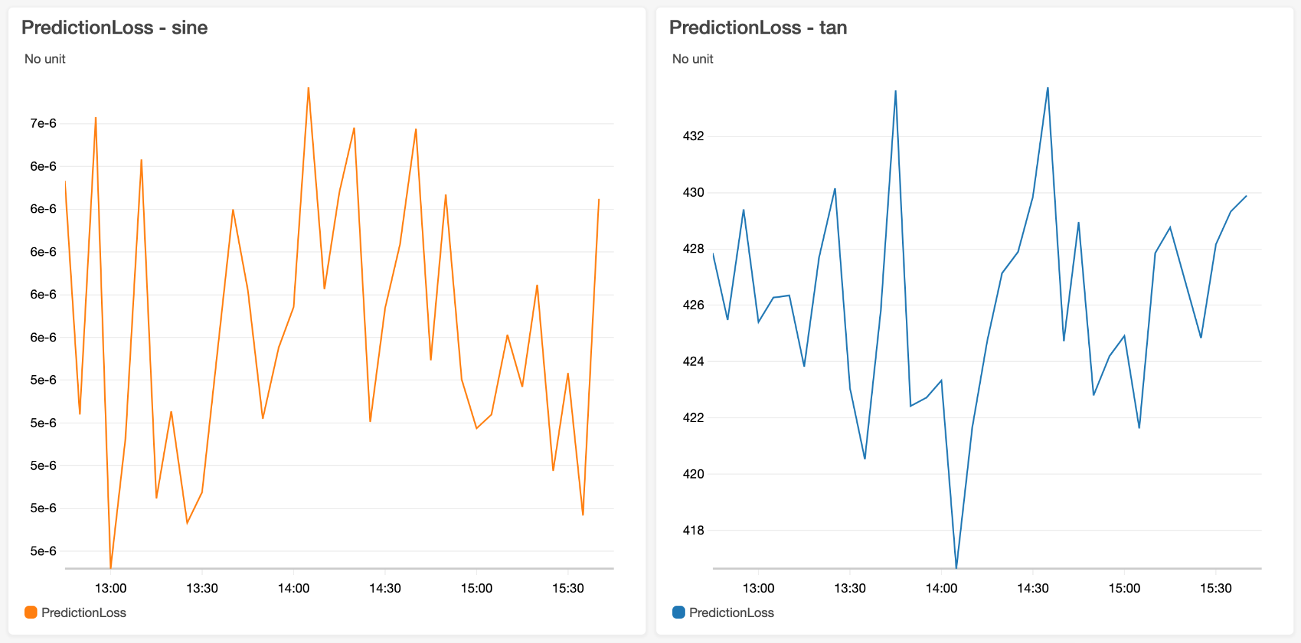
Monitoring toolbox: dashboards
Make monitoring accessible to non-engineering stakeholders
Good for visualizations but insufficient for discovering distribution shifts

Slide 85
Monitoring toolbox: alerts
3 components
Alert policy: condition for alert
Notification channels
Description
Alert fatigue
How to send only meaningful alerts?
## Recommender model accuracy below 90%
${timestamp}: This alert originated from the service ${service-name}

Slide 86
Monitoring -> Continual Learning
Monitoring is passive
Wait for a shift to happen to detect it
Continual learning is active
Update your models to address shifts

